Slide 1
ZUG
  Test automation tool.
  Provides an execution environment for tests specified using CHUR test specification language.
  Platform independent, and can be used on any environment that supports the Java Runtime Environment.

Slide 2
CHUR
A simple test specification language

Slide 3
Why a new technology?
Limitations of existing languages
  Embedded logic / Reusability
  Specialized staff
  Cost of maintenance
The CHUR advantage
  Spreadsheet based language
  Logic is separated from test case implementation
  Very easy to learn.
  Can be used by non programmers
Notes:
Since most of the available automation software use existing languages such as VB Script and JavaScript, the logic of the test case is embedded into it and is difficult to separate form the code. So, if someone wants to reuse the logic then she has to rewrite the whole script or copy it from the source. The language itself does not promote reusability.
Specialized staff is needed to write and maintain test cases as a result the cost of maintenance increases.
CHUR is spreadsheet based language and is designed in such a way that the logic is kept separate form the test cases so that you can reuse the logic for different test cases.
Also, it is easy to learn and use as anyone with basic knowledge of spreadsheets can learn and write automated test cases in it.

Slide 4
Goals/Objectives
You’ll learn to
  Install ZUG
  Design Test Cases and Molecules
  Write and use atoms required by the molecules
  Store and view test results in Zermatt

Slide 5
Concepts and Terminologies
Test Suite : Collection of automated test case. Represented in spreadsheet and consists of following worksheets:
  Config Worksheet
  Macro Worksheet
  TestCases Worksheet
  Molecule Worksheet
  Prototype Worksheet
Test Case : A test case is a set of test steps to test certain feature of a product.
Test Step : A test step consists of a action and verification steps. It can also have some property.
Action : An action is a piece of work that the test case designer wishes to do. Action usually takes some arguments. An action can be an atom of a molecule.
Notes:
1. Download the ZIP archive of the latest ZUG package, from the Automature FTP site.. Please use the username Beta and password automatureBet@
2. Extract the ZUG directory in the archive to your hard drive, e.g. C:\. If there is already an existing version of ZUG installed, extract it in the same existing directory and overwrite the old files.
3. Open a command prompt window and type: installZUG.bat. This will install ZUG and set up the required environment on the system. The ZUG directory is added to the PATH system environment variable. This means that ZUG can be run from anywhere in the command prompt window, one does not have to be in the ZUG directory.
4. Locate a file called sqlitejdbc-v056.jar in the “lib” subfolder inside your ZUG directory.
5. Copy this file into a subfolder in your installed Java directory called “ext”. In most cases the path should be: Program Files\Java\jre6\lib\ext\ . You may have to change the path slightly if you installed it somewhere else.
6. Open a new command prompt window and type: runZUG.bat –version. This is to verify that the correct version of ZUG has been installed. The version number displayed should match the version number of the package that you downloaded in Step 1.

Slide 6
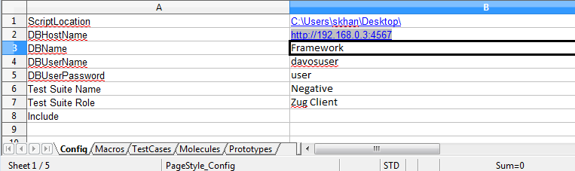
Concepts and Terminologies
Test Suite : Collection of automated test case. Represented in spreadsheet and consists of following worksheets:
  Config Worksheet
    Contains the environment related information.
    Information is typically used by ZUG to locate supporting programs, and upload results into the database.
    Allows references another CHUR spreadsheet files, which contains Molecules and macros to be included.
Notes:
1. Download the ZIP archive of the latest ZUG package, from the Automature FTP site.. Please use the username Beta and password automatureBet@
2. Extract the ZUG directory in the archive to your hard drive, e.g. C:\. If there is already an existing version of ZUG installed, extract it in the same existing directory and overwrite the old files.
3. Open a command prompt window and type: installZUG.bat. This will install ZUG and set up the required environment on the system. The ZUG directory is added to the PATH system environment variable. This means that ZUG can be run from anywhere in the command prompt window, one does not have to be in the ZUG directory.
4. Locate a file called sqlitejdbc-v056.jar in the “lib” subfolder inside your ZUG directory.
5. Copy this file into a subfolder in your installed Java directory called “ext”. In most cases the path should be: Program Files\Java\jre6\lib\ext\ . You may have to change the path slightly if you installed it somewhere else.
6. Open a new command prompt window and type: runZUG.bat –version. This is to verify that the correct version of ZUG has been installed. The version number displayed should match the version number of the package that you downloaded in Step 1.

Slide 7
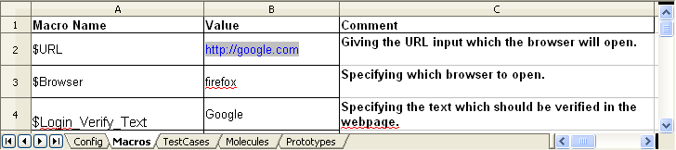
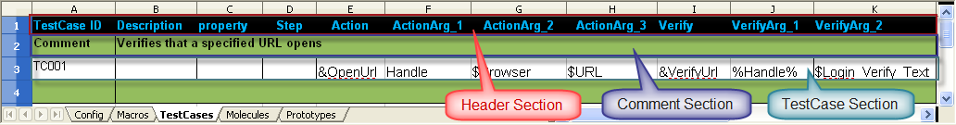
Concepts and Terminologies
  Macro work sheet
    Contains symbolic names called macros.
    Macro allows user to give shorter name to constants that can be used in the test case or molecule.
    Macros value are substituted at the time of execution.
  TestCases Worksheets
Notes:
1. Download the ZIP archive of the latest ZUG package, from the Automature FTP site.. Please use the username Beta and password automatureBet@
2. Extract the ZUG directory in the archive to your hard drive, e.g. C:\. If there is already an existing version of ZUG installed, extract it in the same existing directory and overwrite the old files.
3. Open a command prompt window and type: installZUG.bat. This will install ZUG and set up the required environment on the system. The ZUG directory is added to the PATH system environment variable. This means that ZUG can be run from anywhere in the command prompt window, one does not have to be in the ZUG directory.
4. Locate a file called sqlitejdbc-v056.jar in the “lib” subfolder inside your ZUG directory.
5. Copy this file into a subfolder in your installed Java directory called “ext”. In most cases the path should be: Program Files\Java\jre6\lib\ext\ . You may have to change the path slightly if you installed it somewhere else.
6. Open a new command prompt window and type: runZUG.bat –version. This is to verify that the correct version of ZUG has been installed. The version number displayed should match the version number of the package that you downloaded in Step 1.

Slide 8
Concepts and Terminologies
Notes:
1. Download the ZIP archive of the latest ZUG package, from the Automature FTP site.. Please use the username Beta and password automatureBet@
2. Extract the ZUG directory in the archive to your hard drive, e.g. C:\. If there is already an existing version of ZUG installed, extract it in the same existing directory and overwrite the old files.
3. Open a command prompt window and type: installZUG.bat. This will install ZUG and set up the required environment on the system. The ZUG directory is added to the PATH system environment variable. This means that ZUG can be run from anywhere in the command prompt window, one does not have to be in the ZUG directory.
4. Locate a file called sqlitejdbc-v056.jar in the “lib” subfolder inside your ZUG directory.
5. Copy this file into a subfolder in your installed Java directory called “ext”. In most cases the path should be: Program Files\Java\jre6\lib\ext\ . You may have to change the path slightly if you installed it somewhere else.
6. Open a new command prompt window and type: runZUG.bat –version. This is to verify that the correct version of ZUG has been installed. The version number displayed should match the version number of the package that you downloaded in Step 1.

Slide 9
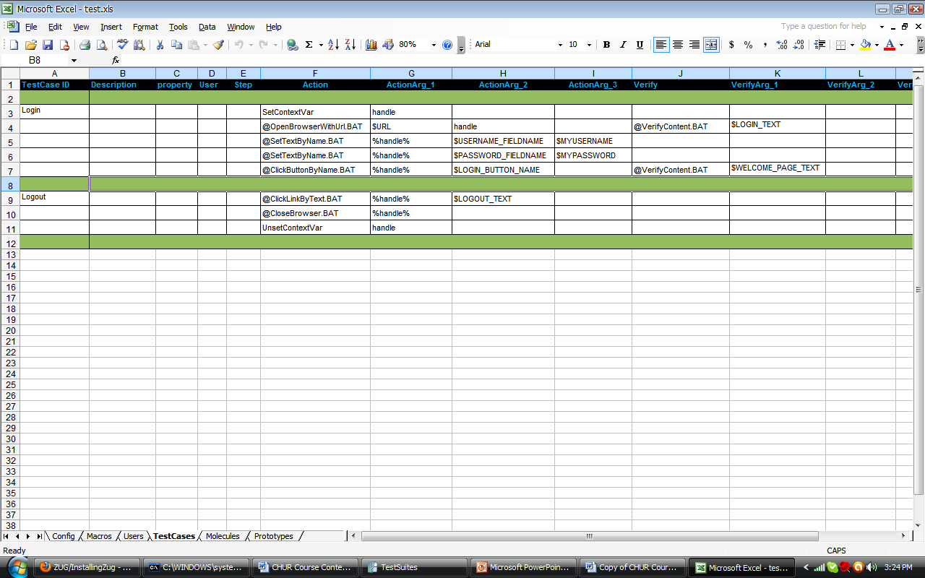
A Simple Test Case
Atoms
Arguments
Macros
Test Case and the Macro Worksheets
Action Steps/ Verification Steps
Commenting a row
How to run ZUG from command prompt
Notes:
What are Atoms
Atoms are small computer programs which are used to perform certain activity e.g.: Click a button, fill a text box, open a browser etc.
What are Arguments
Arguments are values that are passed to atoms and molecules so that they can perform certain task.
Introduction to Macros
Macros are defined in the macro sheet and are assigned a certain value when the macro name is used in a test case or molecule sheet, the macro name is replaced by the assigned value.
Test Case and the Macro Worksheets
Test case sheet contains the definitions of all the test cases and Macro sheet contains all assigned value of the Macros.
Action Steps/ Verification Steps
The action steps contain the list of atoms or molecules that perform some task and the corresponding verification steps verify the successful completion of that task.
How to run ZUG from command prompt

Slide 10
Built-in Atoms : ContextVars
Limitations of Macros:
  Cannot change the values of Macros at run time
  Atoms cannot alter the values of Macros
Purpose
  Can change the value of ContextVar at runtime
  Atoms can access and modify the Content
Notes:
Limitations of Macros
Cannot change the values of Macros at run time
Since the values of Macros are defined before the execution of the test suite, it is not possible to change during execution
Atoms cannot alter the values of Macros
ZUG does not allow the atoms to change the values of Macros so it is difficult to alter the values
Purpose
Can change the value of ContextVar at runtime
ZUG has inbuilt feature to update the value of a ContextVar at any point of time during the execution
Atoms can access and modify the Content
Since it may be required to change the value of the temporary variable at any point ZUG allows atoms to access and change the value of ContextVar

Slide 11
ContextVars
Set/UnSet ContextVars
Passing ContextVars by reference and by value
By Reference
By Value
Notes:
Set/UnSet ContextVars
SetContextVar declares the ContextVar and also updates the value if called for an existing ContextVar, UnSetContextVar deletes the ContextVar. The values assigned to ContextVars are stored as strings and can be converted to other types inside the atoms as required.
Passing ContextVars by reference and by value
A ContextVar can be passed to atoms or molecules by value or by reference.
When passed as value, atoms can read the content but cannot modify it. The syntax to pass the ContextVar as value is %ContextVar_Name%.
And when passed as reference atoms can access and modify the content of the ContextVar. The syntax to pass the ContextVar as reference is ContextVar_Name.

Slide 12
ContextVars and Atoms
Reading And Altering Context Variable values from Atoms ( HarnessAPI.DLL)
  Log: void Log("loglevel", "message")
  AlterContextVar: void AlterContextVar(name, value)
  GetContextVar: value = GetContextVar(name)
Notes:
HarnessAPI.Dll is a COM DLL which exposes functionality related to retrieving and updating Context Variable. It also contains functionality to log diagnostic messages from atoms.
The Log function sends a diagnostic message to the Atom Log. The syntax for log is - Log("loglevel", "message") where “loglevel” can be debug, error or fatal, info.
When log level is debug message is printed on Debug and Primitive log files.
When log level is error or fatal message is printed on Debug, Error and Primitive log files.
When log level is info message is printed on Debug, Primitive and PrimitiveErrors log files.
AlterContextVar alters the value of the context variable. It accepts two arguments, the ContextVar name and the value to be updated with.
GetContextVar retrieves the context variable value. It accepts one argument, the ContextVar name for retrieving its value.

Slide 13
ZUG COM DLL
Ruby/Watir
require 'rubygems'
require 'watir'
require 'win32ole'
harnessCOMObj=WIN32OLE.new("AutomationHarness.HarnessAPI")
temp=harnessCOMObj.GetContextVar(ARGV[0].to_i)
temp++
harnessCOMObj.log("debug","Value = #{temp}")
harnessCOMObj.AlterContextVar(ARGV[0], temp)
Notes:
This is an example atom implemented in Ruby. The atom accepts a ContextVar as its first argument and increments the value by one.
The first function call “GetContextVar” retrieves the values of the ContextVar sent to the atom as the first argument and stores it in the variable called temp.
The second function call “log” sends a message to the atom log with the value stored in the variable.
The third function call “AlterContextVar” stores the incremented value of temp in the ContextVar.

Slide 14
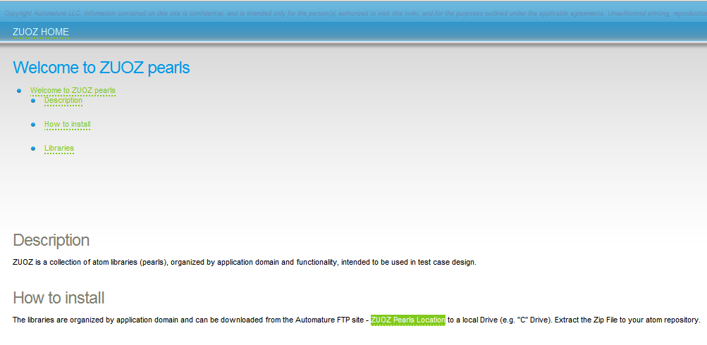
ZUOZ Library
Repository of implemented atoms
ZUOZ Pearls Location
Notes:
ZUOZ is a collection of atom libraries (pearls), organized by application domain and functionality, intended to be used in test case design.
The libraries can be downloaded from the Automature FTP site – ZUOZ Pearls Location ftp://automature.com:33621/Field%20Test%20Kits/ZUOZ/Beta1.0

Slide 15
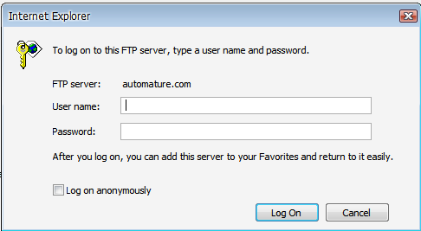
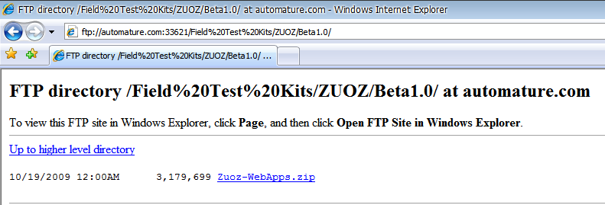
ZUOZ : Downloading atoms
Notes:
In order to access the FTP site username and password are required, after logging in atoms can be downloaded as a zip file.
Extract the Zip File to your atom repository.

Slide 16
Exercise : ContextVars
Write a test case to read the title of the page and store it in a ContextVar, use the same ContextVar to set another text field.
More at
http://www.automature.com/twiki/bin/view/ZUG/ChurBasicConcepts
Notes:
Example sheet – Test001

Slide 17
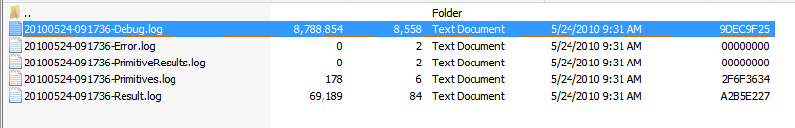
Debugging
Debug the test cases for error correction
  ZUG Logs
Notes:
ZUG creates and stores debug log files while executing a test suite. They are stored in “C:\Documents and Settings\Current User\Application Data\ZUG Logs” if database reporting is false and are stored in “C:\ZUG\LogArchive” if database reporting is true.
There are five types of log files created by ZUG namely- Debug, Error, PrimitiveResults, Primitives, Result.
The Debug log stores track flow.
The Error log stores the errors occurred while execution.
The PrimitiveResult log stores the results of the atoms.
The Primitives log stores the logs created by the atom.
Results log stores the console output.

Slide 18
AppendToContextVar
Concatenates multiple values
Built-in feature
Action column or Verify column
Any number of values can be appended
Notes:
AppendToContextVar is similar to string concatenation, it will combine all the values sent to it as argument to form a single string.
It is a built-in feature so it is fast and can be called between any two test steps.
AppendToContextVar can be called in the action column or the verification column, any number of values can be appended to it.

Slide 19
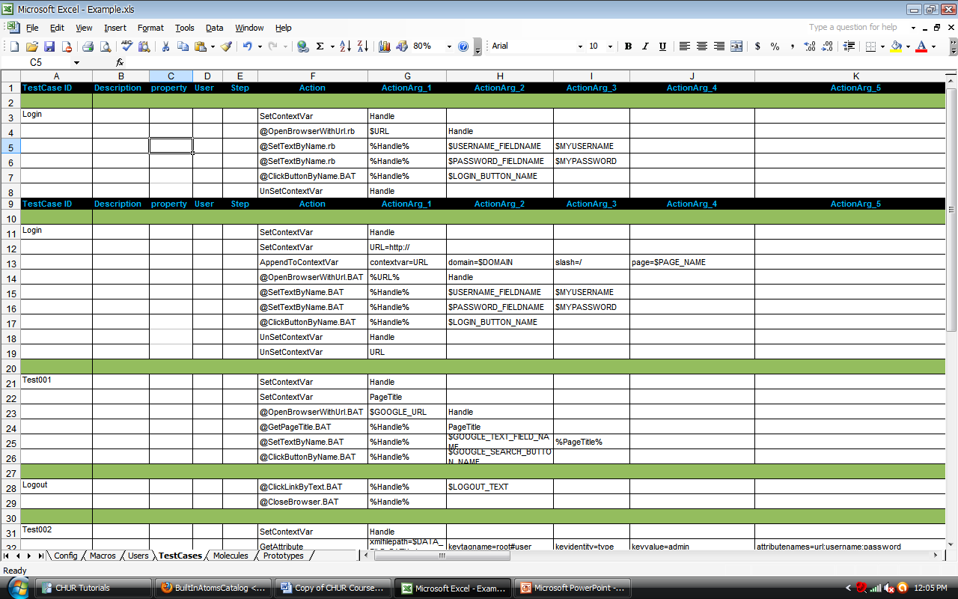
Example : AppendToContextVar
Creating a URL by appending the domain name and the page name.
Notes:
It should be in key=value pair. Minimum one "key=value" pair should be their. Their can be multiple "key=value" pair if user wants different value to be append. Each pair will be different ActionArg or VerifyArg.
For ex. Action can be "AppendToContextVar" and its Action arguments can be contextvar=URL, domain=$DOMAIN, slash=/, page=$PAGE_NAME respectively. Then contextvar “URL" value will be modified to a complete url.

Slide 20
Exercise : AppendToContextVar
Write a test case to create refined search query by appending values to it.
  For example if the first query is “test” then the second query can be “test automation”
More at
http://www.automature.com/twiki/bin/view/ZUOZ/BuiltInAtomsCatalog
Notes:
Example sheet – Test002

Slide 21
Global Context Variables
ZUG_TPSTARTTIME
ZUG_TCSTARTTIME
ZUG_TSSTARTTIME
ZUG_TESTSUITEID
ZUG_BASETCID
ZUG_TCID
ZUG_TCYCID
ZUG_TESTPLANID
ZUG_TOPOSET
ZUG_TOPO
ZUG_TESTSUITE_TIMEOUT
ZUG_TESTSTEP_TIMEOUT
UserName
UserPassword
UserDomain
Notes:
ZUG_TPSTARTTIME Timestamp when Test Suite execution started. Value set by ZUG when the test suite execution is started
ZUG_TCSTARTTIME Timestamp when Test Case execution started. Its value updated by ZUG when each new test case execution started
ZUG_TSSTARTTIME Timestamp when Test Step execution started. Variable value updated by ZUG when new Test step execution started
ZUG_TESTSUITEID Test Suite Name
ZUG_BASETCID Base Test Case ID
ZUG_TCID Generated Test Case ID
ZUG_TCYCID Test Cycle ID
ZUG_TESTPLANID Test Plan ID
ZUG_TOPOSET Topology SET ID
ZUG_TOPO Topology ID. Comma Separated list of Topology ID's participating in the Automation for testing.
ZUG_TESTSUITE_TIMEOUT Test Suite Timeout. This will contain the maximum time in seconds for which a test suite can execute. By default its value will be 2*60*60 seconds. One can use this context variable to change the default behavior of timeout dynamically during the test suite execution.
ZUG_TESTSTEP_TIMEOUT Test Step Timeout. This will contain the maximum time in seconds for which a test step can execute. By default its value will be 30*60 seconds. One can use this context variable to change the default behavior of timeout dynamically during test suite execution.
UserName Name of the User executing the test case. This is set by ZUG before the test case is started.
UserPassword Password of the User executing the test case. This is set by ZUG before the test case is started.
UserDomain Domain of the User executing the test case. This is set by ZUG before the test case is started.

Slide 22
Built-in Atoms : XML
Limitations of Macros:
  Cannot keep multiple values
  Single dimensional (non hierarchy)
Purpose:
  Multi-dimensional
  Can keep multiple data sets
  Data can be organized in better a way
Notes:
Macros can keep only one value at time and if we need to test with different input sets macros are not helpful. As the value of a Macro is fixed so every time we want to test with a different data set we need to change the value of the macro.
Also, Macros are single-dimensional while xml allows you to store multi-dimensional data.
In xml file we can keep multiple values and read the values that we want to test with. Also xml is a very organized way of storing data.

Slide 23
XML Introduction
Attributes and Tags
<root>
<user type="admin" url="https://www.mail.com/login.aspx">
<username>testaccount18@mail.com</username>
<password>mypassword</password>
</user>
</root>
Attribute
Tags
Notes:
Basically XML document contains information that are inside the Tags or the Attributes. ZUG provides built-in atoms to read the values of Tags and Attributes.
Element
A logical component of a document which either begins with a start-tag and ends with a matching end-tag, or consists only of an empty-element tag. The characters between the start- and end-tags, if any, are the element's content, and may contain markup, including other elements, which are called child elements. An example of an element is <Greeting>Hello, world.</Greeting>
Tag
A markup construct that begins with "<" and ends with ">". Tags of three types : start-tags, for example <section>, end-tags, for example </section>, and empty-element tags, for example <line-break/>.
Attribute
A markup construct consisting of a name/value pair that exists within a start-tag or empty-element tag. In the example (below) the element img has two attributes, src and alt: <img src="madonna.jpg" alt='by Raphael'/>. Another example would be <step number="3">Connect A to B.</step> where the name of the attribute is "number" and the value is "3":

Slide 24
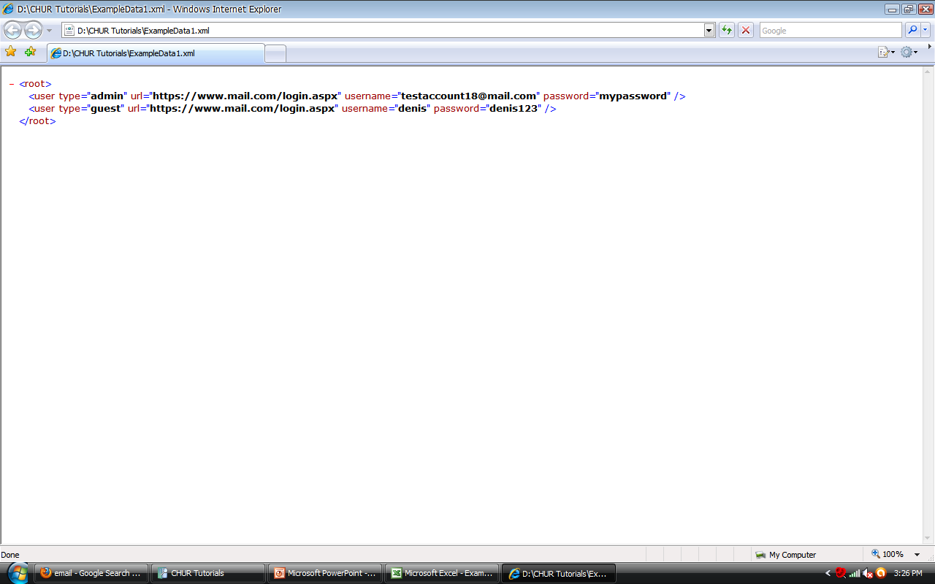
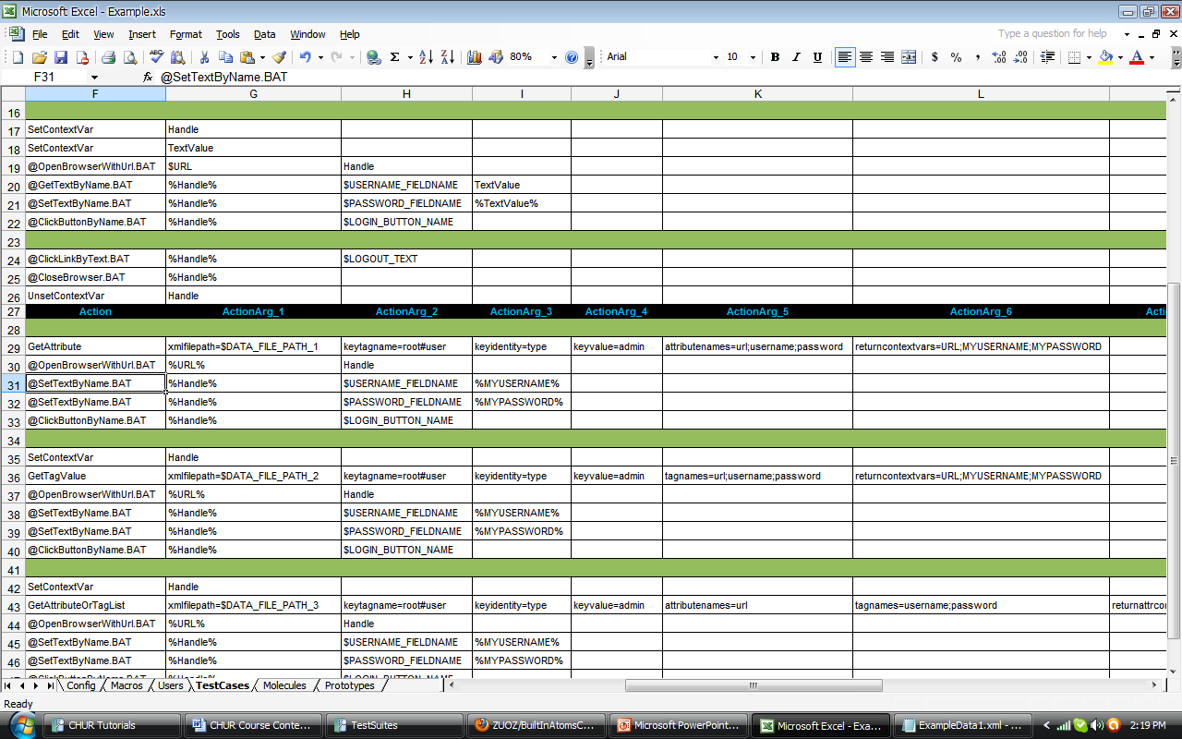
XML : GetAttribute
Notes:
GetAttribute retrieves the value of an attribute inside a XML element, given the name and value of the key.
The values of the attributes are stored in the list of context variables sent to it as arguments.
The GetAttribute action accepts 6 (six) arguments viz.
“xmlfilepath” – the path of the xml file where it is located.
“keytagname” - The hierarchical relationship from the root element to the element in focus.
“keyidentity” - Name of the attribute in the element in focus whose value is compared to input argument KeyValue .
“keyvalue” - Value of the attribute mentioned in the KeyIdentity to identify the element in focus
“AttributeName” - Name of the attribute whose value needs to be read.
“ReturnContextVar” - Name of the context variable in which the return value needs to be stored.

Slide 25
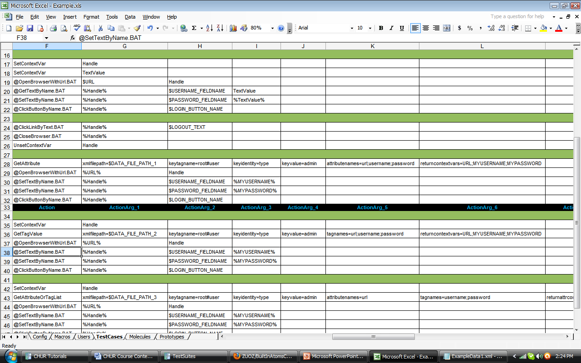
XML : GetTagValue
Notes:
GetTagValue retrieves the value of a tag inside a XML element, given the name and value of the key.
The values of the attributes are stored in the list of context variables sent to it as arguments.
The GetTagValue action accepts 6 (six) arguments viz.
“xmlfilepath” – the path of the xml file where it is located.
“keytagname” - The hierarchical relationship from the root element to the element in focus.
“keyidentity” - Name of the attribute in the element in focus whose value is compared to input argument KeyValue .
“keyvalue” - Value of the attribute mentioned in the KeyIdentity to identify the element in focus
“TagName” - Name of the attribute whose value needs to be read.
“ReturnContextVar” - Name of the context variable in which the return value needs to be stored.

Slide 26
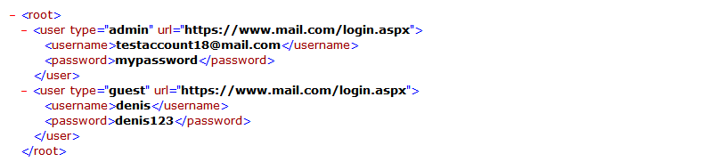
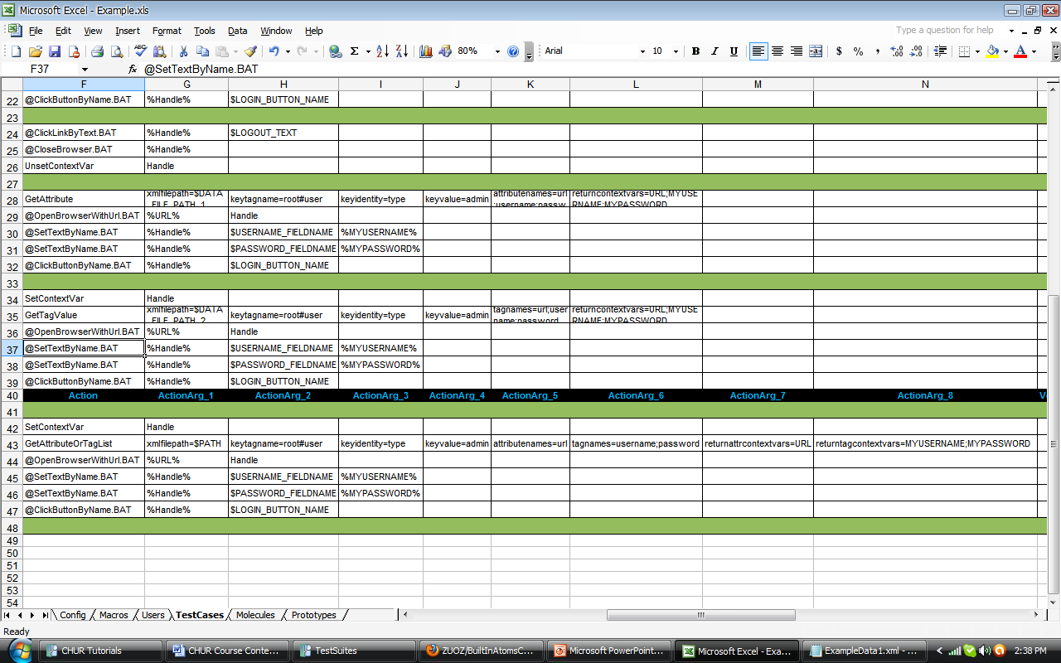
XML : GetAttributeOrTagList
Notes:
GetAttributeOrTagList retrieves the value of multiple attributes and/or tags inside a XML element, given the name and value of the key.
The values of the attributes are stored in the list of corresponding context variables sent to it as arguments.
The GetAttribute action accepts 8 (eight) arguments viz.
“xmlfilepath” – the path of the xml file where it is located.
“keytagname” - The hierarchical relationship from the root element to the element in focus.
“keyidentity” - Name of the attribute in the element in focus whose value is compared to input argument KeyValue .
“keyvalue” - Value of the attribute mentioned in the KeyIdentity to identify the element in focus
“AttributeName” - Name of the attributes whose value needs to be read.
“TagName” - Name of the tags whose value needs to be read.
“ReturnAttrContextVar” - Name of the context variable in which the return value needs to be stored.
“ReturnTagContextVar” - Name of the context variable in which the return value needs to be stored.

Slide 27
Exercise : XML
Write a test case which will read the xml file and run the test case with different input datasets.
More at
http://www.automature.com/twiki/bin/view/ZUOZ/BuiltInAtomsCatalog
Notes:
Example Sheet - Test005

Slide 28
Molecules
Limitations Test cases
  Difficult to reuse the test case logic
  Difficult to maintain
Purpose
  Reusability of the test case logic
Notes:
Test Case logic once implemented cannot be reused by another test case.
As the logic is embedded in the test case so if we want to use the same logic we need copy and paste to another test case.
Molecules are basically the reusable logic that can be used by multiple test cases without making any change in the design of the molecules.

Slide 29
Molecules
Collection of several steps
Has a name it can be referenced by
Can be invoked by a test case, or another molecule
Accept input arguments, and can also pass data back to the caller
May invoke another molecule, an external, or a "built-in" atom
Notes:
Molecules are collections of test steps which contains several atoms or other molecules.
Each molecule can be referred by a name so that it can be called from a test case or another molecule.
A molecule can take in multiple input arguments which can be ContextVars, Macros or Texts.
A molecule can invoke another molecule, external molecule from a different Test suite or a built-in atom.

Slide 30
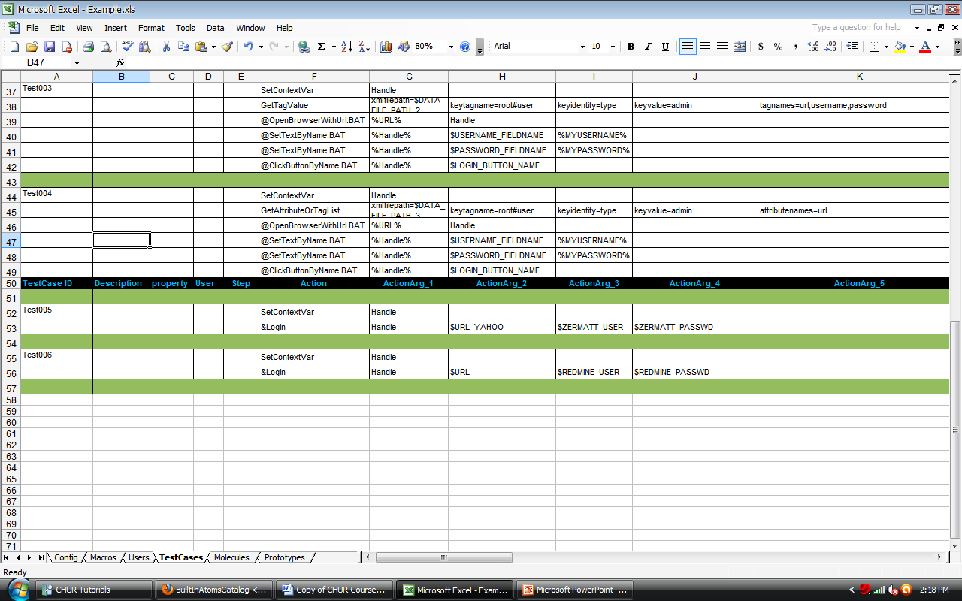
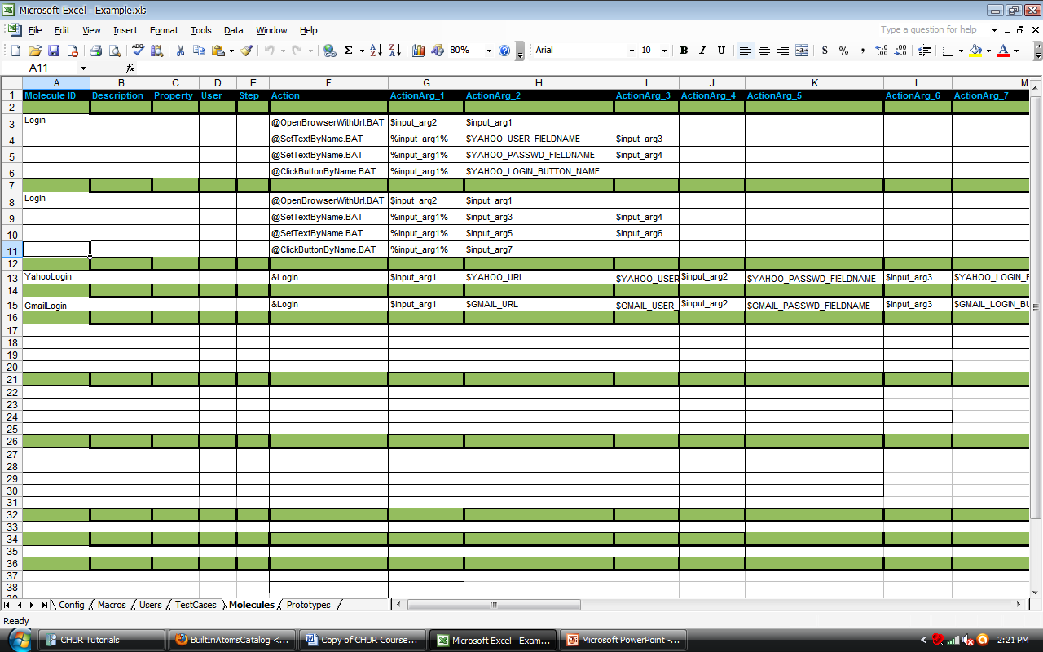
Example : Molecule
Notes:
Passing arguments to molecules
Passing values to molecules is similar to passing values to atoms.
Receiving values in molecules
The values sent to molecules can be received in molecules by using $input_arg1, input_arg2 and so on by the order in which they are passed to it.
Calling molecules in test cases
Molecules can be called in test cases appending ‘&’ sign in front of the molecule name.
Returning values from molecules
ContextVar sent as input argument can used to return values form the molecules.

Slide 31
Exercise : Molecules
Write test cases using a single login molecule to login to various sites with different username and password
More at
http://www.automature.com/twiki/bin/view/ZUG/ChurBasicConcepts
Notes:
Example Sheet - Test006 & Test007

Slide 32
Multi-valued Macros (MVM)
Limitations of current technologies:
  Data driven testing is complex
Purpose:
  Allows user to test with various input data
  Increases the scope of a test case
Notes:
Data driven tests are complex as it is not very user friendly to test with multiple data sets. Multi-valued Macros allows you to test with multiple data sets.
When used in the testcase worksheet, allows ZUG to auto-generate unique testcases using a new combination of values from each of the MVMs used in the testcase.
Test case identifiers are automatically generated by ZUG, by concatenating the base id with the combination values
When used inside the molecules worksheet, invokes the step multiple times, each time with a new combination of values (within the context of the parent test case).

Slide 33
Multi-valued Macros (MVM)
Multi-value macros (MVM) contain lists of values
SYNTAX:
$$QUERY={test +automation, test -automation}
Primarily used as iteration vehicles
Can be used inside a test case or a molecules
Notes:
Multi-valued macros (MVM) contain lists of values, When used in the test case worksheet, allows ZUG to auto-generate unique test cases using a new combination of values from each of the MVMs used in the test case.
When used inside the molecules worksheet, invokes the step multiple times, each time with a new combination of values (within the context of the parent test case).
To declare Multi-valued Macros, the syntax is double dollar with a name as suffix e.g. $$macro_name in the first column of the Macro sheet and its corresponding value is written in the second column inside the curly braces as comma separated list e.g. {a, b, c}.

Slide 34
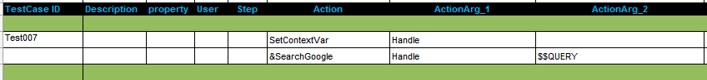
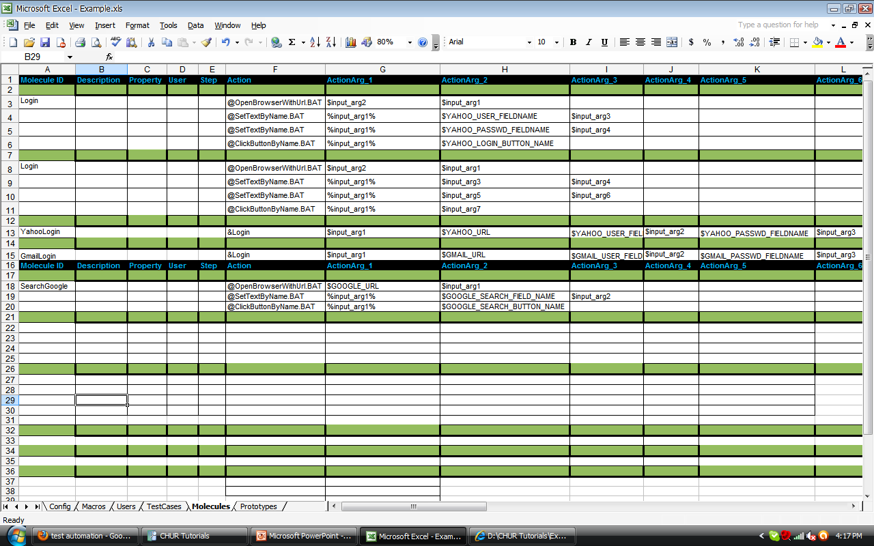
MVM in Test Case
The same test case can test with multiple search queries
Notes:
$$QUERY is used which has the two values (test +automation, test –automation)
So when the test case is run it would take the first value “test + automation” and the second time it would take the second value “test – automation”
Hence the same test case will generate unique test case ids for different values of the MVM.

Slide 35
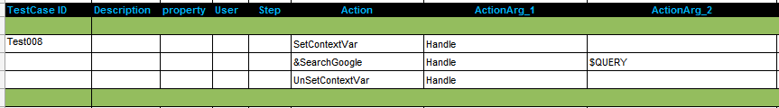
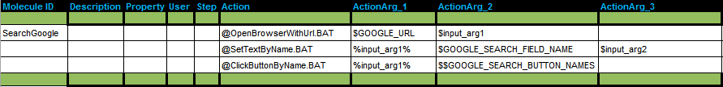
MVM in Molecule
Test Case
Molecule

Slide 36
MVM Features
Range of values
  e.g. {1..3} or {a..k}
Test Case identifications are auto-generated
  e.g. Test001_1, Test001_2 and so on.
Syntax for passing MVMs
Notes:
MVM can contain a range of values that can be specified as {1..5}, then the MVM will be treated as a list with values {1,2,3,4,5}.
When MVMs are used inside a Test Case it autogenerates the test case identifier with MVM values appended to the original test case identifier to make them unique.
MVM values are comma (,) separated so you should be careful not use comma inside the braces.

Slide 37
Exercise : MVM
Write a test case to search in Google with different queries in a single MVM
Notes:
Example Sheet - Test008

Slide 38
Concurrent Execution
Concurrently executes multiple steps
  Test Case
  Molecules
Test Case/Molecule having same step number
Notes:
Concurrent execution enables users to execute multiple test steps concurrently.
Concurrent execution can be applied to both the test cases and the molecules
If two or more different actions of a test case/molecule has the same step number, then these different steps would be executed concurrently by ZUG.

Slide 39
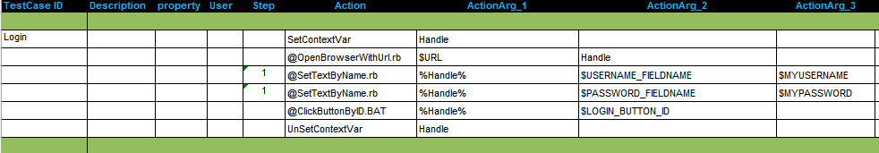
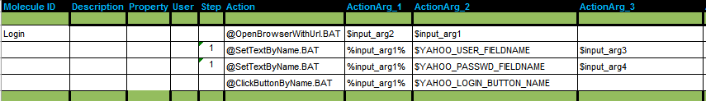
Example : Concurrent Execution
Test Case
Molecule
Notes:
In this slide there is a test case and a molecule
Considering the test case
Usually one action would be executed after another
In this case as there is a similar number mentioned on the step column for two of the actions , hence both the actions would be executed concurrently however different the actions may be.
Considering the molecules
Usually one action would be executed after another
However in this case as there is a similar number mentioned on the step column for two of the actions , hence both the actions would be executed concurrently

Slide 40
Exercise : Concurrent Execution
Write a test case to concurrently search in Google and Yahoo in different browser.
Notes:
Example Sheet - Test009

Slide 41
Exception Handling
Limitations of Test cases:
  If test cases fail in way that it affects the next test cases, it becomes difficult to run the next cases
Purpose:
  Exception handling
Notes:
Test cases have certain limitations. If a test case fails for any reason then it becomes difficult for the next test case to run
Hence exception handling is used to come out of the test case which is not ale to run so that the next test case can be run

Slide 42
Exception Handling
Initialization & Cleanup for
Test Case/Molecule
Initialization & Cleanup for Test Suite
Timeout for test steps/cases
Notes:
Exception handling can be done by Initialization and Cleanup steps.
Initialization & cleanup are available for Test case , molecule and Test suite.
When the initialization step fails the cleanup step is executed and comes out of the test case.
Also it is possible to set a time limit for each step so that it does not wait for it indefinitely to finish.

Slide 43
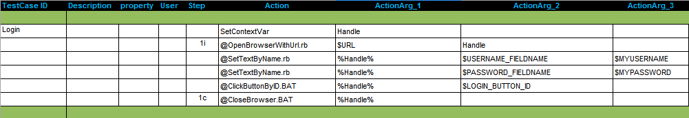
Exception Handling : Test Case
Initialization & Cleanup steps
Notes:
In a test case the action column consists of several steps which are executed sequentially. If a step fails then the whole test case fails and it comes out the test case reporting it as failed.
In the example step 2 is the initialization step and step 6 is the clean up for it. So, if step 2 fails then automatically the cleanup will be executed for the test case.

Slide 44
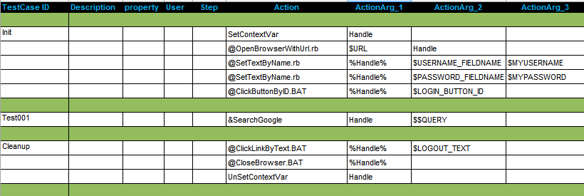
Exception Handling : Test Suite
Initialization & Cleanup Test Case
Notes:
A test suite can have a initialization and cleanup test cases, initialization case is executed automatically and then the other test cases in the suite.
The cleanup test case is executed even if all the cases fail so that the clean up for the test suite is done.
Both initialization and clean up are not reported to the database.

Slide 45
Exercise : Exception Handling
Write a test case that uses initialization and cleanup steps for searching in google.
Notes:
Example Sheet - Test009

Slide 46
External Sheets
Limitation of using Test Suite:
  Cannot use molecules that are defined in some other test suite
  Copy and paste is difficult to maintain
Purpose:
  Reuse the existing molecules/Macros and maintain a single copy

Slide 47
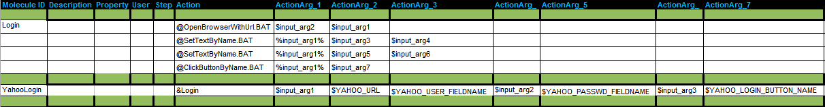
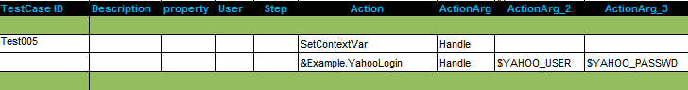
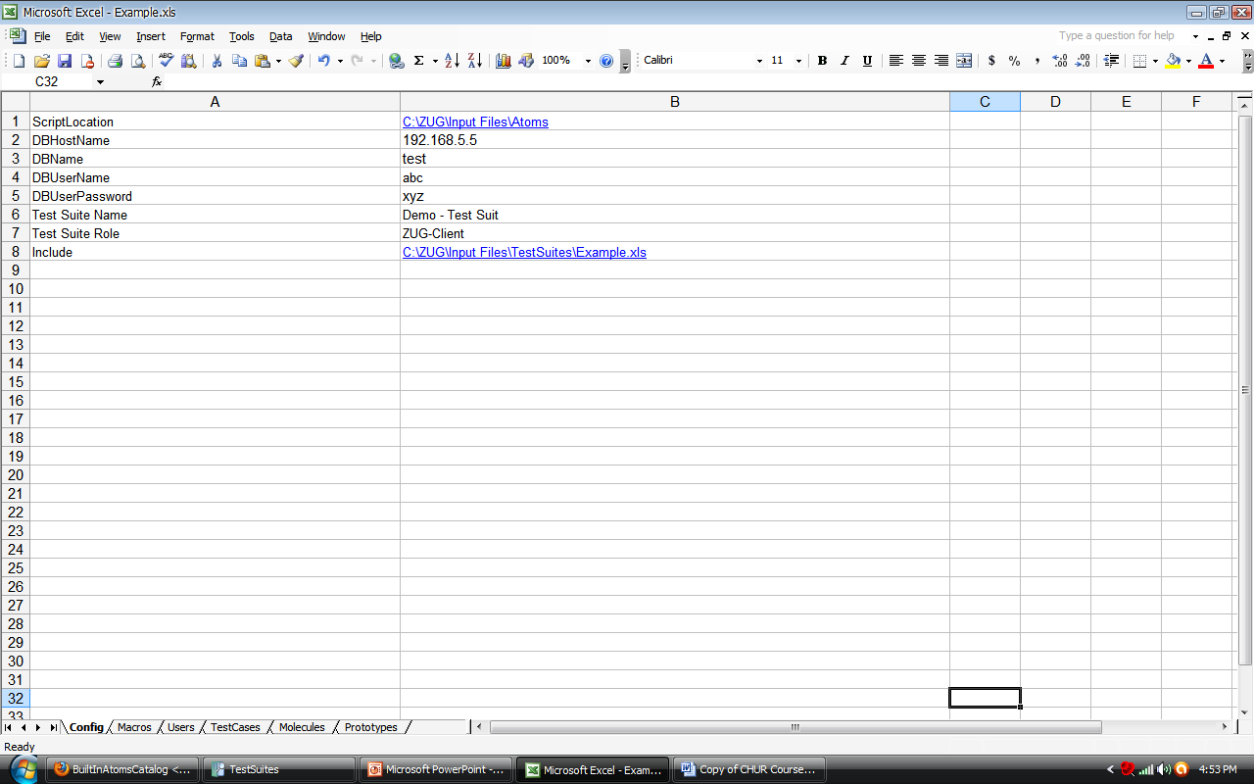
Example : External Molecules
These molecules are in a file named Example.xls
Filename - Namespace
File path of Example.xls needs to be mentioned in the config sheet
Notes:
ZUG also allows the test suite designer to reference molecules and macros defined in files, other than the current input file. This promotes reusability of existing design molecules.
Since each external file is assumed to contain unique names, but name uniqueness cannot be guaranteed between all referenced files, the concept of namespaces are used. The filename is used as the namespace to call the molecules and Macros in it.

Slide 48
Exercise : External Molecules
Login to Gmail and YahooMail using external molecules.
Notes:
Example Sheet - Test011 & Test012

Slide 49
Work Sheets
Config
Macros
Test Cases
Molecules
Prototypes
Help
Notes:
Config
This section is where environmental information is described. This information is typically used the Harness to locate supporting programs, and upload results into the Framework database.
Macros
This section allows the testcase designer to declare short names that can then be substituted in the testcase descriptions during execution. This information is integral to the logic of the decomposed test steps, and does not relate to the execution environment.
Users
This is where user credentials are stored. Currently, this worksheet is not used. The intent is that a test step could potentially be executed using a different user's account, than is currently logged in.
Test Cases
This is where individual test cases and their variables are listed. Also, the initialization and cleanup steps for the entire test plan is listed here.
Abstraction
This is where the collections of steps (for a test case) are described, and assigned names. Abstract Test Cases are similar to macros, that are expanded to provide the detailed test case action steps during runtime.
Prototypes
This is the place where one should specify the footprint (i.e. the number and names of formal arguments of invocable entities) for primitives and abstractions. This allows the Harness to do syntax checks.
Help
This section contains the description of the columns in the worksheets

Slide 50
Longevity Mode
Runs a selection of test cases repeatedly
Cleanup is run only once
Records a single result as the outcome.
Notes:
The Harness allows the user to run a selection of test cases repeatedly, for a specified duration, or a specified number of iterations.
Longevity tests run the test plan setup and cleanup only once, and record a single result as the outcome.

Slide 51


Longevity : Options
Repeat
  Count
  Duration
Notes:
Count: how many times the test cases mentioned in the test plan will be executed in iteration. -Count=nnn
Duration: how long the test cases mentioned in the test plan will be executed in iteration. -Duration= 3d

Slide 52
ZUG Options
Selective Test Case execution
Performance mode (verification off)
Stress testing
More at
http://www.automature.com/twiki/bin/view/ZUG/ZugOptions
Notes:
Selective Test Case execution
Comma Separated list of Automated Test Case IDs If specified, ZUG will execute only specific test cases as listed and will ignore the rest.
Performance mode
To execute the testcase without verification. By default, verificationswitching is TRUE means ZUG will run verification actions for each testcase unless explicitly disbaled (in which case ZUG will not run any Verifications).

Slide 53
Database Reporting & Log Archival
Config Sheet
Test Plan ID
Topology Set
Test Cycle
Notes:
Config sheet needs the following information to connect to the database for reporting
ScriptLocation – the location of the atoms required for the test suite
DBHostName – the hostname/IP of the DB server
DBName – the database name
DBUserName – username for the database
DBUserPassword - password for the database
Test Suite Name – Name of the test suite
Test Suite Role – Role of the test suite
Include – path of the file to be included
Test Plan id is to be mentioned so that ZUG knows where to dump the result of the execution.
Topology set specifies the machines to be used.
Every time ZUG creates a new test cycle for reporting the result of the execution under the test plan.

